Slide 1
Multimodality and Large Multimodal Models
by David Chen, Ren Zhou, Hannah Zhou

Slide 2
Part I: Motivation and Overview
Hannah Zhou

Slide 3
Motivation to Multimodality:
Limitations of Single Modality:
Traditional machine learning models focus on a single data modality E.g: text, image, audio
limits its ability to fully understand and interact with the complex, multimodal nature of real-world environments E.g: healthcare, robotics, e-commerce, retail, gaming
Human Intelligence as a Benchmark:
Nature intelligence integrates multiple modalities. We read, speak, observe, and listen simultaneously, using all these inputs to make informed decisions
Notes:
Without it

Slide 4
Motivation to Multimodality:
Potential Improved Performance:
A model that can learn from both text and images should perform better than one that learns from only text or only images
Incorporating data from other modalities → performance boost
Flexible Interaction Interface:
Imagine being able to ask a question by typing, talking, or just pointing your camera at something
Allowing richer and more intuitive interaction for users
Notes:
With it Possibility: Advancements in AI and Computing Power made it feasible to develop systems that can handle multimodal data effectively.
/ Incorporating additional modalities to LLMs (Large Language Models) creates LMMs (Large Multimodal Models). Not all multimodal systems are LMMs. For example, text-to-image models like Midjourney, Stable Diffusion, and Dall-E are multimodal but don’t have a language model component /

Slide 5
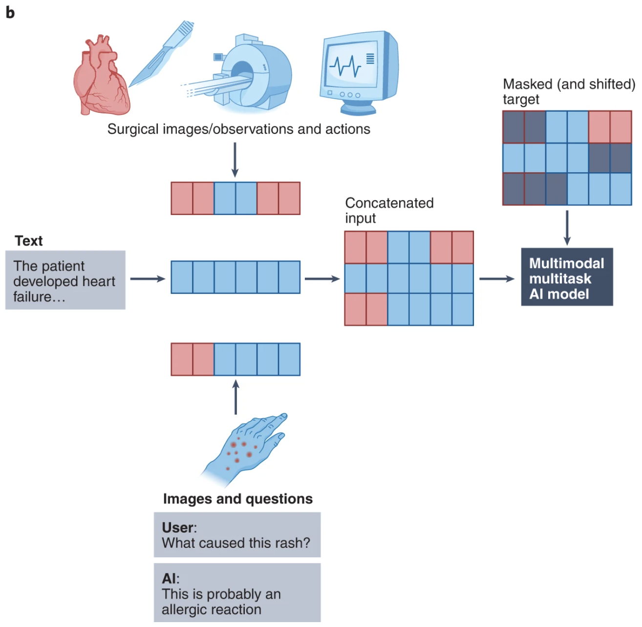
Multimodal Systems Effectively Process and Integrate Multiple Data Modalities, Such as Text, Images, and Audio, to Enhance Understanding and Information Generation Capabilities
Workflow of a multimodal, multi-task AI model It processes inputs like surgical images and text data. Using this to generate predictive outputs, such as answering questions.

Slide 6
Data Modalities:
Three Types of Multimodal:
{text, image, audio, tabular data… } One data mode can be represented or approximated in another data mode
An image can be represented as a vector, which, in turn, can be flattened and represented as a sequence of text tokens
A text can be represented as an image if you simply take a picture of it ….
we focus on「images and text」to generalize insights to others
Input and output are of different modalities E.g. text-to-image, image-to-text
Inputs are multimodal E.g. a system processes both text and images
Outputs are multimodal E.g: a system generates both text and images
Notes:
Restrictions lied in data modalities: There are other data modalities we haven’t touched on, such as graphs and 3D assets. We also haven’t touched on the formats used to represent smell and touch (haptics). {Images are versatile for representing various data types as inputs, while text excels as an output for diverse tasks.so ….}

Slide 7
Multimodal
Large Multimodal Models (LMMs)
Incorporating additional modalities to LLMs (Large Language Models) creates LMMs
Not all multimodal systems are LMMs
text-to-image models like Stable Diffusion, and Dall-E are multimodal but don’t have a language model component

Slide 8
Multimodal tasks: Generation
Image generation (text-to-image synthesis)
Dall-E, Stable Diffusion, Midjourney
Text generation
visual question answering
Instead of relying only on text for the context, you can point your camera to anything and ask questions like: “My car won’t start. What’s wrong with it?” or “What is this meme about?”
image captioning
used as part of a text-based image retrieval system
Using AI generated captions and metadata for large image-database
Notes:
Multimodal tasks

Slide 9
Multimodal tasks: Vision-Language Understanding (VLU)
VLU refers to all tasks that don’t require generation
Classification
generate outputs from a predetermined list of classes, suitable for tasks with fixed outcomes
E.g: OCR systems predict known characters (digits or letters)
Can enhance broader context understanding for applications like interacting with textbooks or contracts
related task: Image-to-text retrieval
matches images with predefined texts, useful for product image searches
Text-based Image Retrieval (Image Search):
important for search engines and enterprises to search internal images and documents
two Approaches:
refer to captioning in text generation, then match text queries with these captions/metadata
more popular: Train a joint embedding space for images and text, using embeddings to find the closest matches to text queries
Notes:
Multimodal tasks

Slide 10
Part II: Technical Details
David Chen

Slide 11
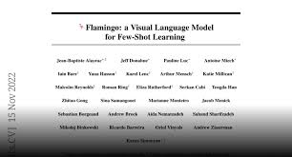
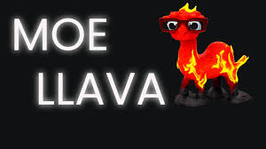

CLIP: Contrastive Language-Image Pre-training
Key idea:
Map text and images into a shared embedding space
Training:
Contrastive learning (12x training efficiency than language model objective)
Use cases:
Rerank generated images
Image encoder
Image encoder

Slide 12
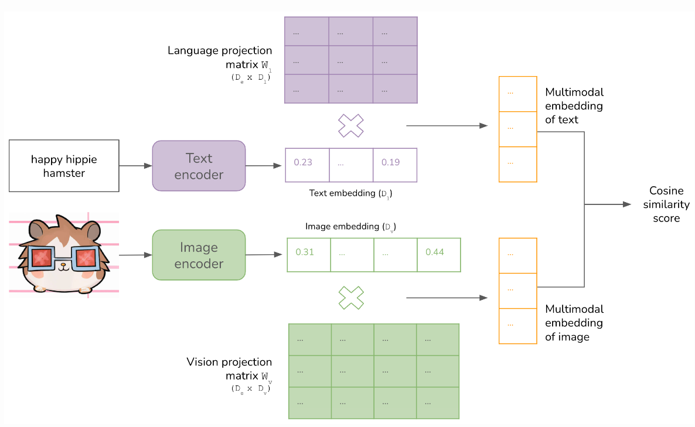
High-Level Architecture of CLIP

Slide 13
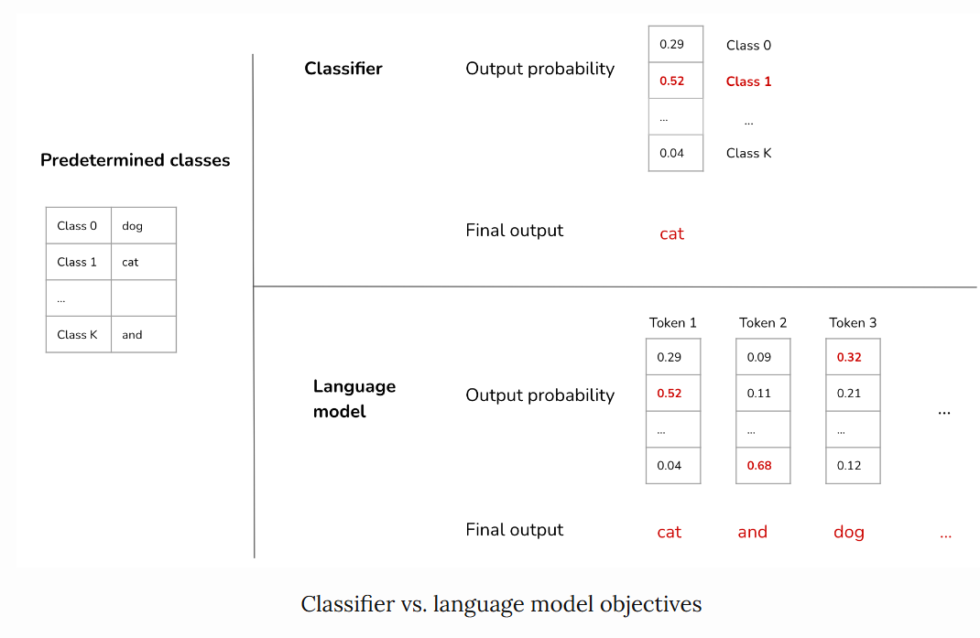
Contrastive learning

Slide 14
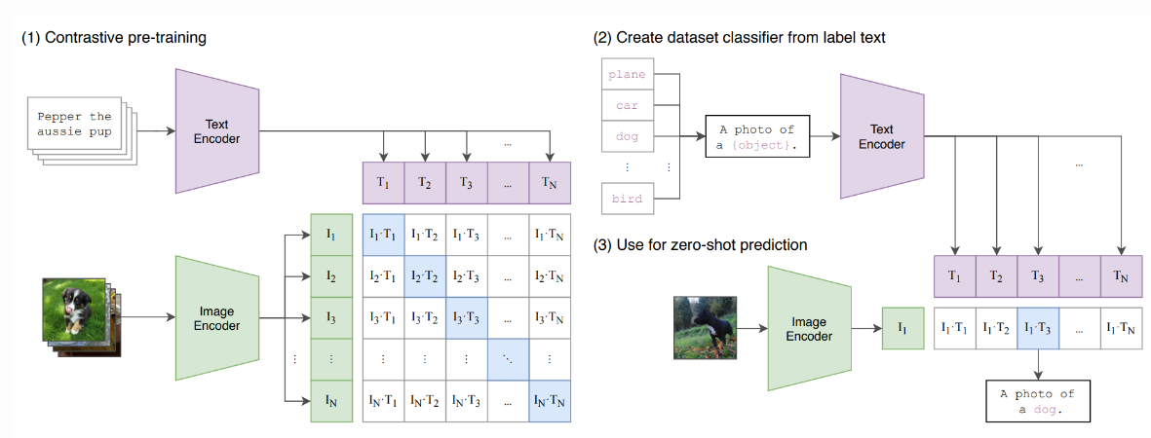
Contrastive learning

Slide 15
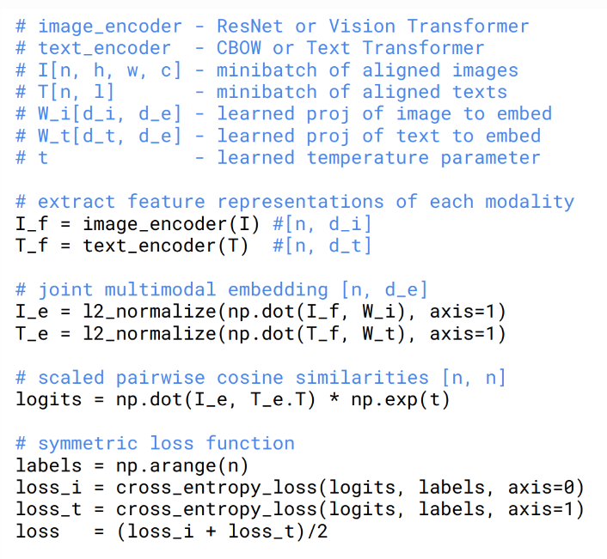
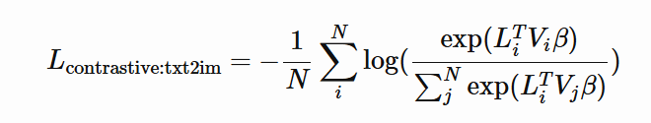
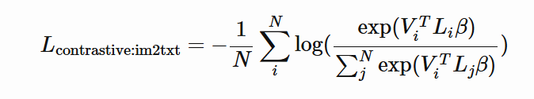
Contrastive learning
Cost function:
+

Slide 16
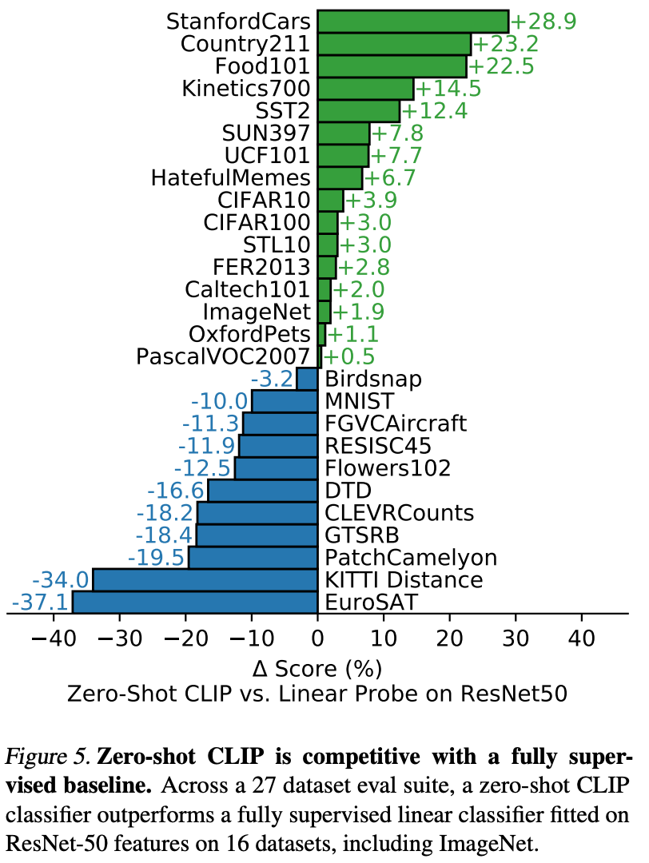
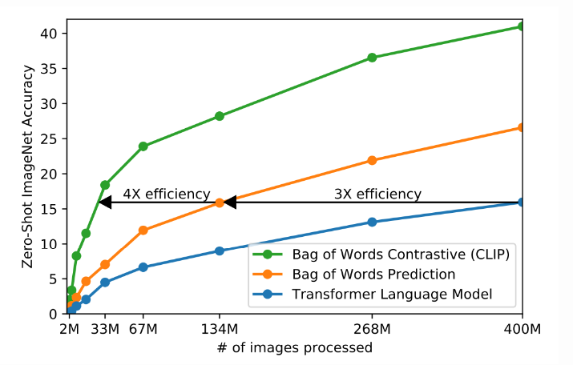
Contrastive learning

Slide 17
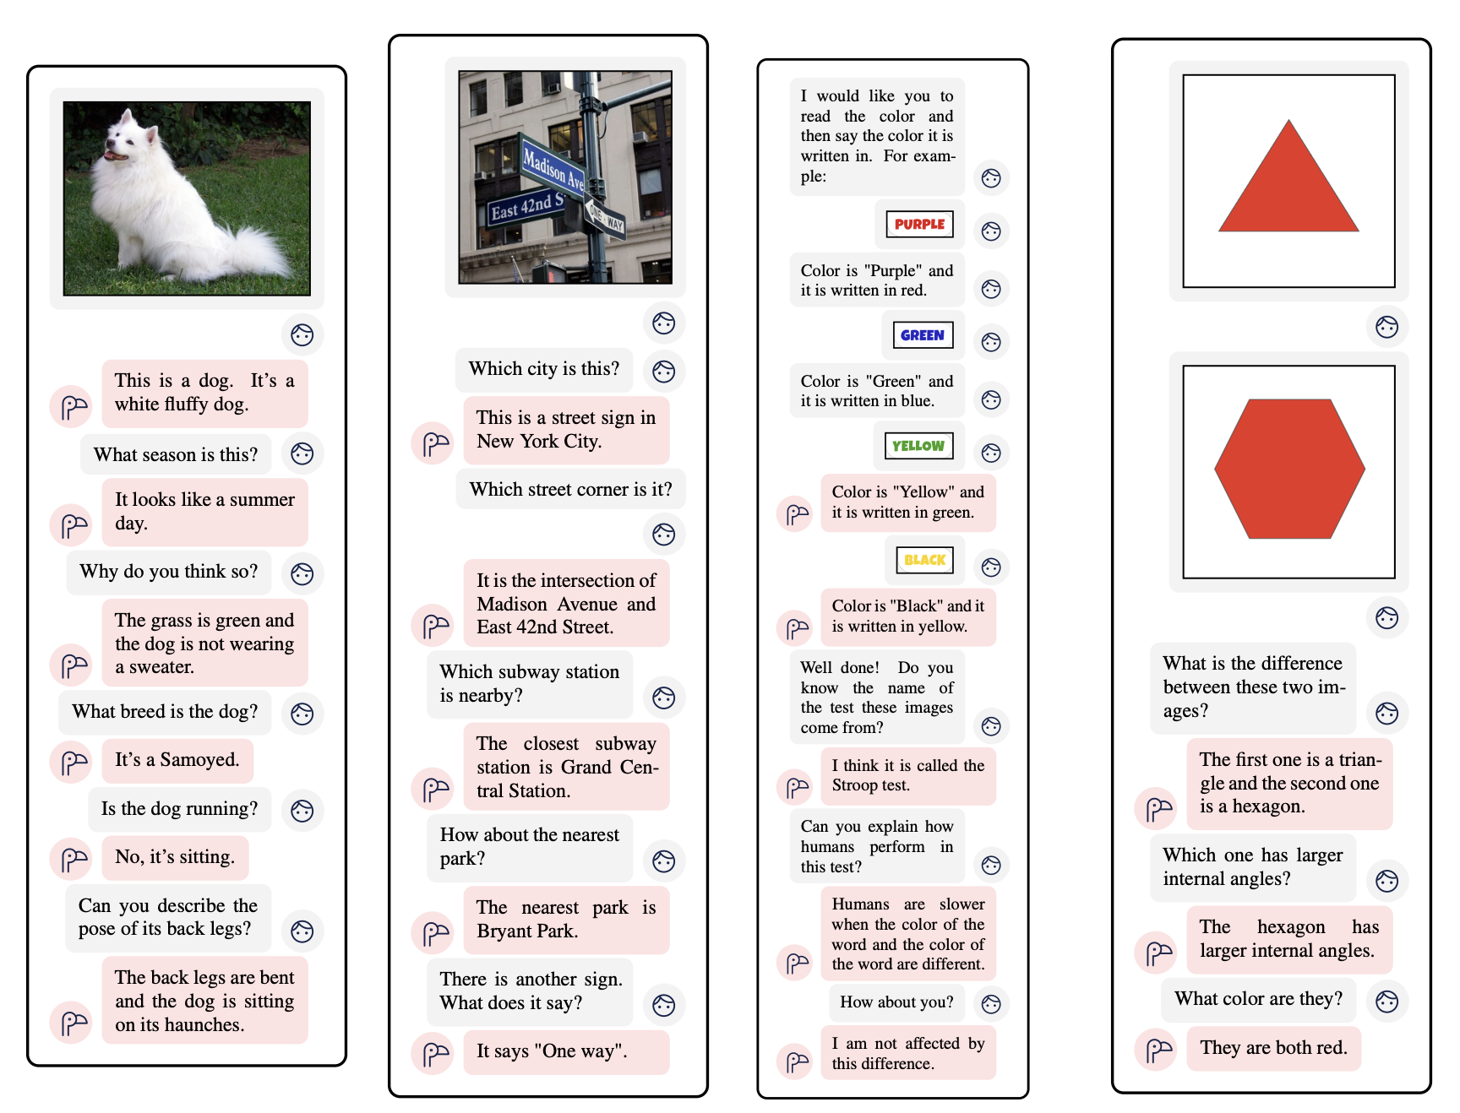
Flamingo: a Visual Language Model for Few-Shot Learning
Unlike CLIP, Flamingo can generate text responses
Flamingo is a language model that added techniques to generate text tokens conditioned on both visual and text inputs

Slide 18
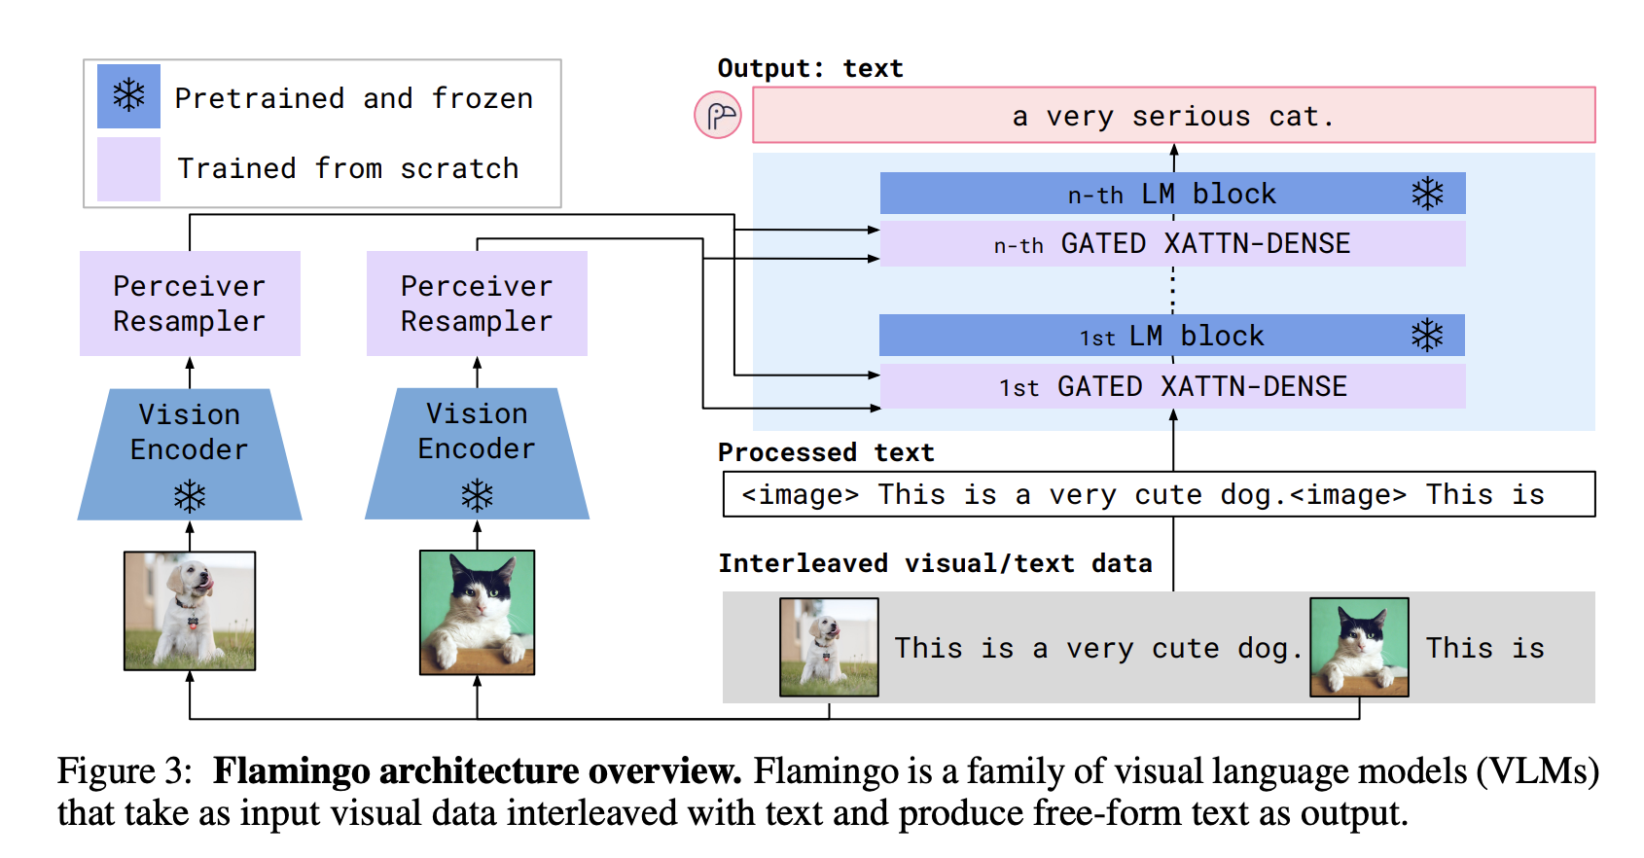
High-Level Architecture of Flamingo

Slide 19
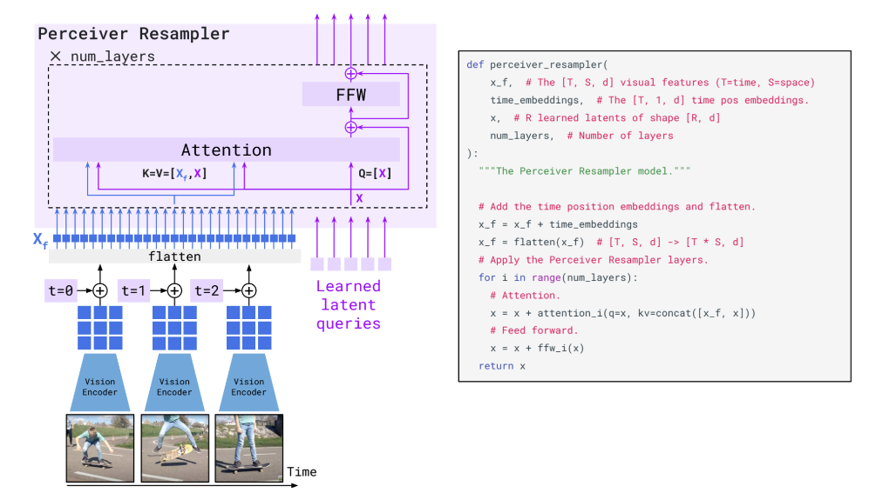
High-Level Architecture of Flamingo

Slide 20
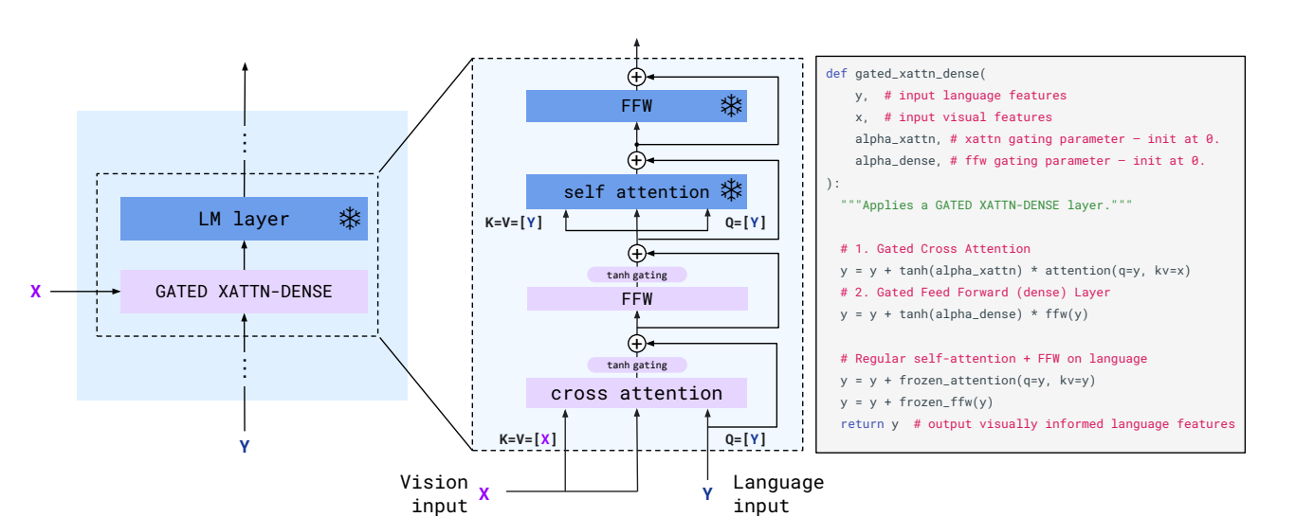
High-Level Architecture of Flamingo

Slide 21
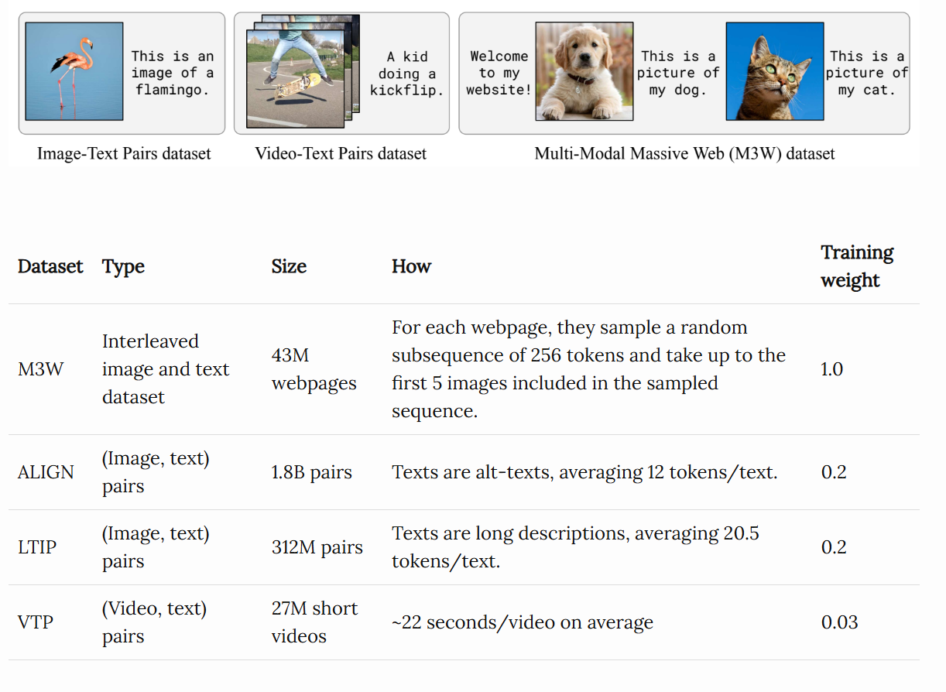
Dataset

Slide 22
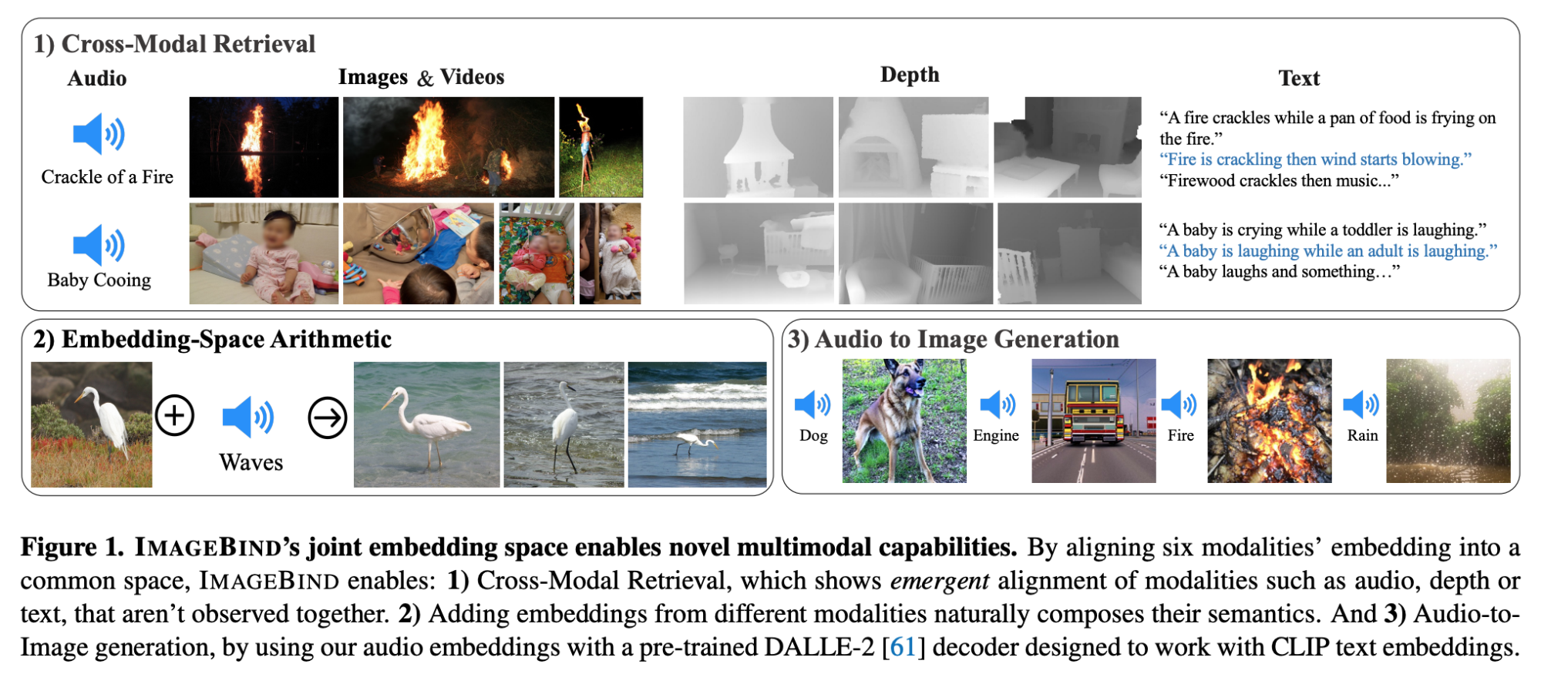
More data modalities

Slide 23
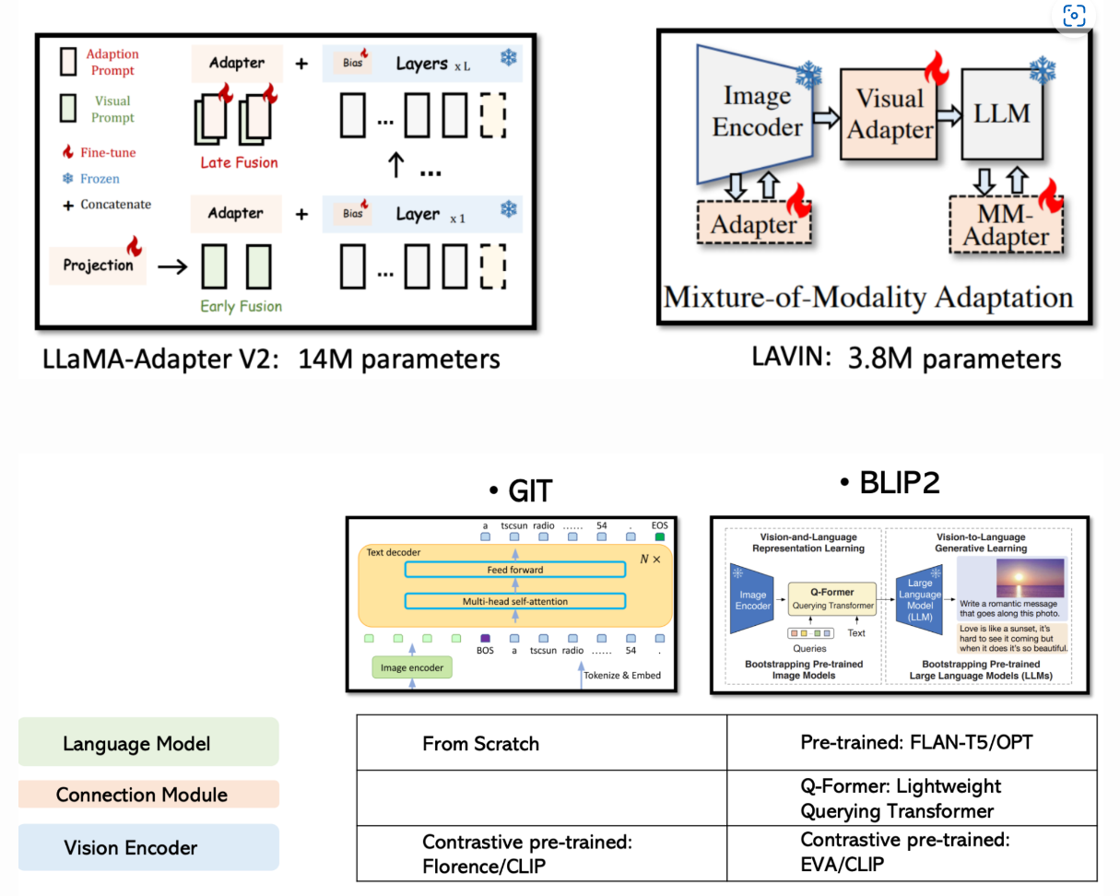
Adapters for more efficient multimodal training
Allow reusing of existing models
Reducing the number of trainable parameters

Slide 24
Part III: Advancements, Technique, and Future Challenges
Ren Zhou

Slide 25
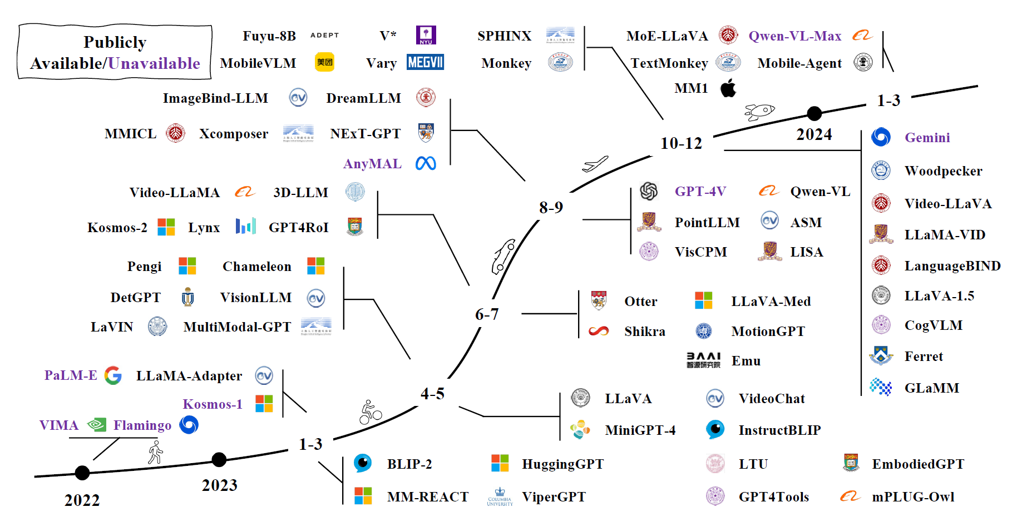
Timeline of MLLMs
https://arxiv.org/abs/2306.13549

Slide 26
Trends in MLLMs
Multimodal content comprehension and text generation | Image-text understanding | BLIP-2, LLaVA, MiniGPT-4, OpenFlamingo
 | Video-text understanding | VideoChat, Video-ChatGPT, LLaMA-VID
 | Audio-text understanding | QwenAudio
Specific modality outputs | Image-text output | GILL, Kosmos-2, Emu, MiniGPT-5
 | Speech/audio-text output | SpeechGPT, AudioPaLM
Any-to-any multimodal comprehension and generation | Amalgamate with external tools | VisualChatGPT, HuggingGPT, AudioGPT
 | End-to-end | NExT-GPT, CoDi-2, ModaVerse

Slide 27
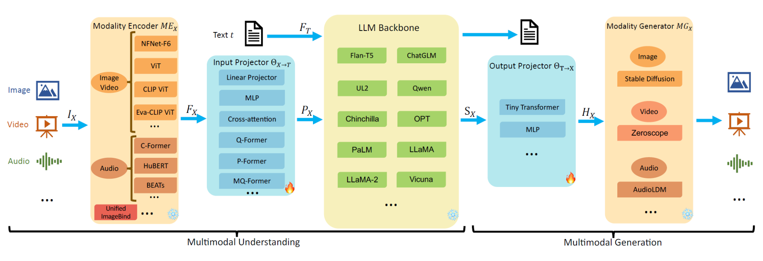
Typical Structure and Components of MLLMs
Main Components: Modality Encoder, Input Projector, LLM Backbone, Modality Generator, Output Projector
https://arxiv.org/abs/2401.13601

Slide 28
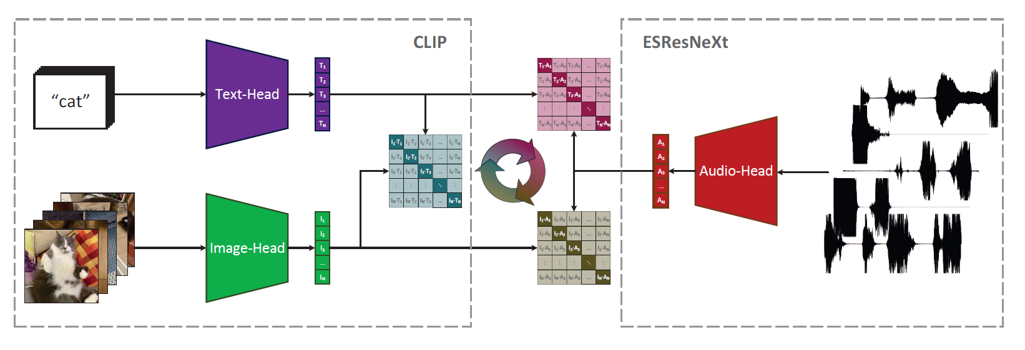
Audio Modality Alignment: Audio CLIP
https://arxiv.org/abs/2106.13043

Slide 29
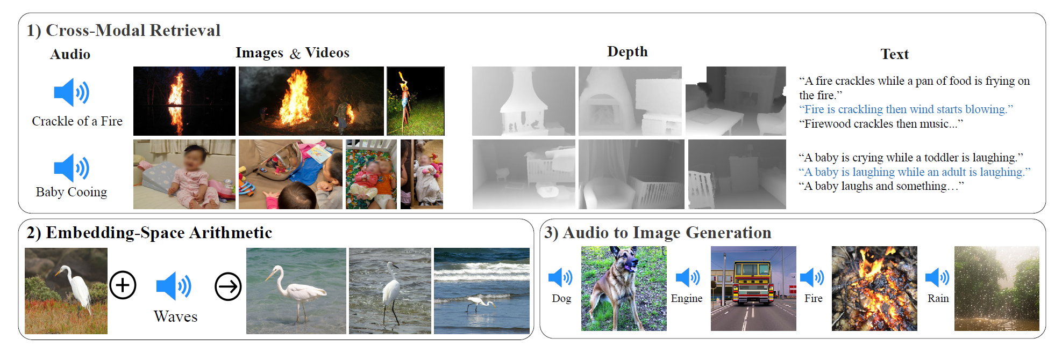
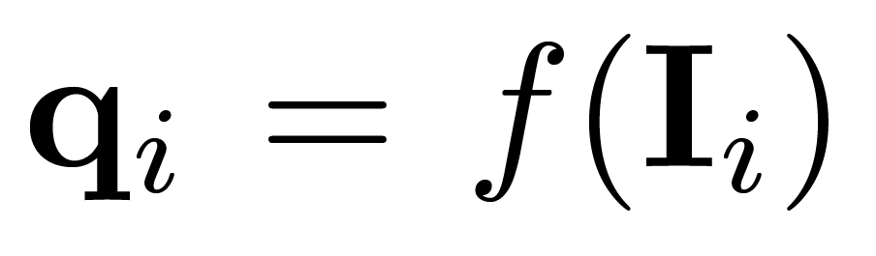
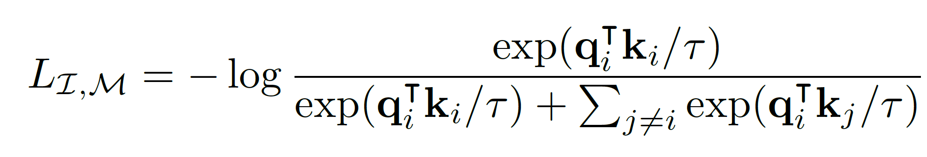
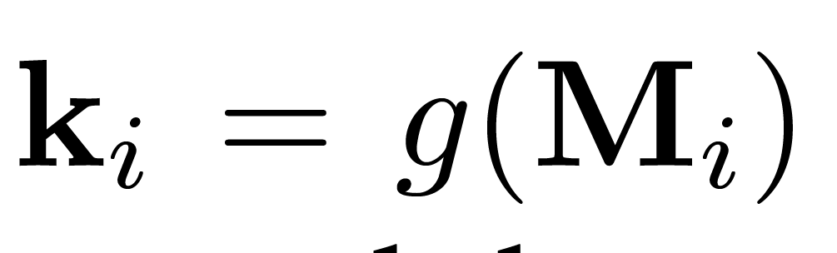
Unified Modalities Alignment: Image Blind
https://arxiv.org/abs/2305.05665
Demo

Slide 30
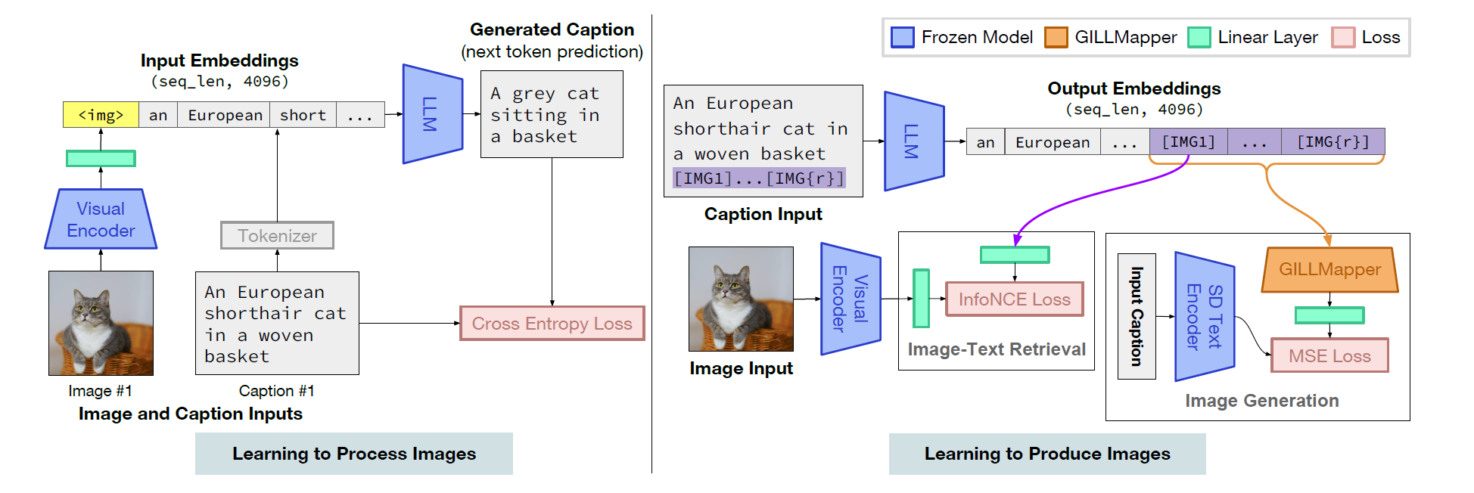
Image Modal Generator: GILL
https://arxiv.org/abs/2305.17216

Slide 31
Pre-training & Instruction Tuning
Pre-training
Align different modalities
learn multimodal world knowledge.
Example training data:
Input: <image>
Response: <text>
Instruction Tuning
Boost zero-shot performance
Better understand instructions
Example training data:
Instruction: <instruction>
Input: <image> <text>
Response: <text>

Slide 32
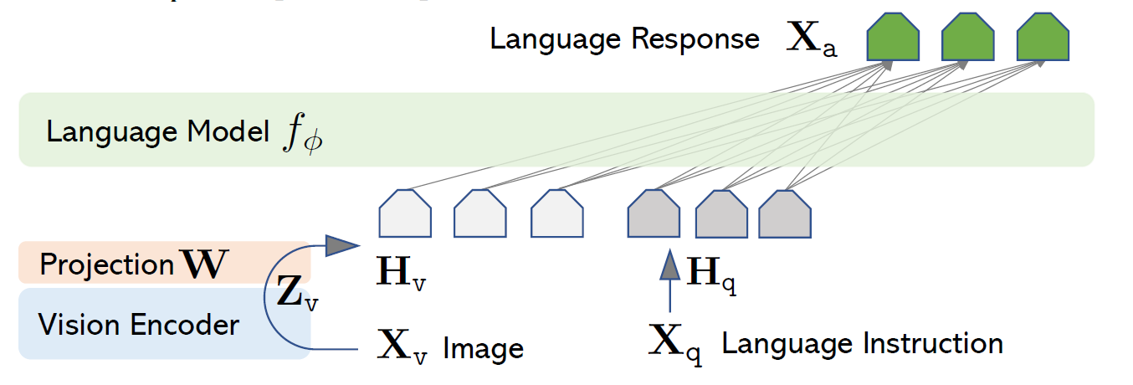
MultiModal Fine-Tuning: Vision Instruction Tuning
https://arxiv.org/abs/2304.08485

Slide 33
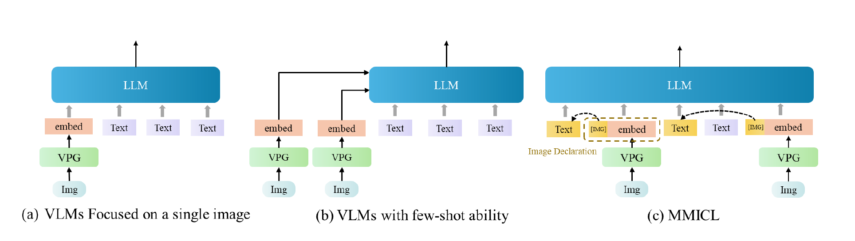
Multimodal In-Context Learning: MM-ICL
https://arxiv.org/abs/2309.07915

Slide 34
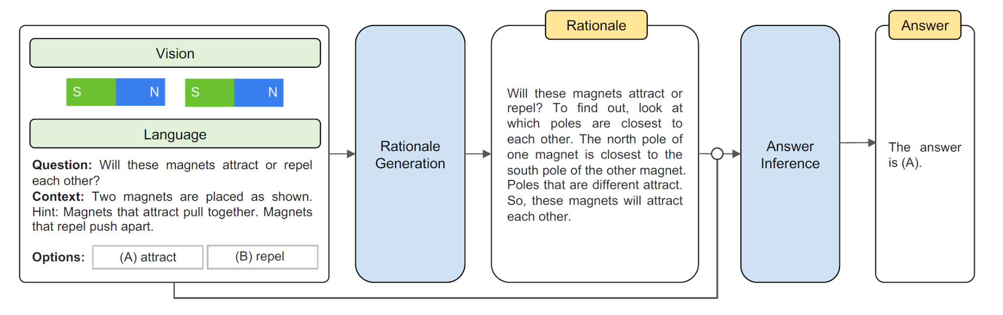
Multimodal Chain of Thought: MM-COT
Chain of Thought: Introduce a series of intermediate reasoning steps
https://arxiv.org/abs/2302.00923

Slide 35
Future Challenges & Directions:
Hallucination Mitigation | LLaVA-RLHF, HallE-Switch, Woodpecker
Long Context MultiModal Information | LongVLM, Mobility VLA
Mobile/Lightweight Deployment | MobileVLM, TinyGPT-V
Embodied Intelligence | PaLM-E, EmbodiedGPT
……

Slide 36
Reference
Yao, Zhewei, et al. "DeepSpeed-VisualChat: Multi-Round Multi-Image Interleave Chat via Multi-Modal Causal Attention." arXiv preprint arXiv:2309.14327 (2023).
Huyen, Chip. “Multimodality and Large Multimodal Models (LMMs).” Chip Huyen, 10 Oct. 2023, huyenchip.com/2023/10/10/multimodal.html.
Alayrac, Jean-Baptiste, et al. "Flamingo: a visual language model for few-shot learning." Advances in neural information processing systems 35 (2022): 23716-23736.
Yin, Shukang, et al. "A survey on multimodal large language models." arXiv preprint arXiv:2306.13549 (2023).
Zhang, Duzhen, et al. "Mm-llms: Recent advances in multimodal large language models." arXiv preprint arXiv:2401.13601 (2024).
Liu, Haotian, et al. "Visual instruction tuning." Advances in neural information processing systems 36 (2024).
Guzhov, Andrey, et al. "Audioclip: Extending clip to image, text and audio." ICASSP 2022-2022 IEEE International Conference on Acoustics, Speech and Signal Processing (ICASSP). IEEE, 2022.
Girdhar, Rohit, et al. "Imagebind: One embedding space to bind them all." Proceedings of the IEEE/CVF Conference on Computer Vision and Pattern Recognition. 2023.
Koh, Jing Yu, Daniel Fried, and Russ R. Salakhutdinov. "Generating images with multimodal language models." Advances in Neural Information Processing Systems 36 (2024).
Zhao, Haozhe, et al. "Mmicl: Empowering vision-language model with multi-modal in-context learning." arXiv preprint arXiv:2309.07915 (2023).
Zhang, Zhuosheng, et al. "Multimodal chain-of-thought reasoning in language models." arXiv preprint arXiv:2302.00923 (2023).

Slide 37
Many Thanks!

